Slide 1
Chapter 9 Objects & Classes

Slide 2
All-in-one source file
source.cpp //how we’re used to doing it #include <iostream> #include <string> using namespace std; string msg( );
int main() { string messg; messg = msg(); cout << messg << “Good-bye” << endl; return -2; }
string msg( ) { return “Hello World!\n”; }

Slide 3
msg.h or msg.hpp #ifndef MSG_HPP #define MSG_HPP //libraries needed for msg.cpp #include <string> //function prototypes string msg( );
#endif
Separate source files
source.cpp #include <iostream> #include “msg.h” using namespace std; int main() { string messg; messg = msg(); cout << messg << “Good-bye” << endl; return -2; }
msg.cpp #include “msg.h” string msg( ) { return “Hello World!\n”; }
//alternative msg.h #pragma once //libraries needed for msg.cpp #include <string> //function prototypes string msg( );
Notes:
some compilers create .hpp rather than .h. They are the same thing

Slide 4
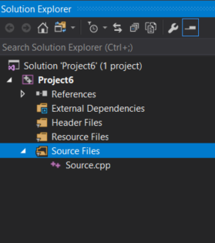
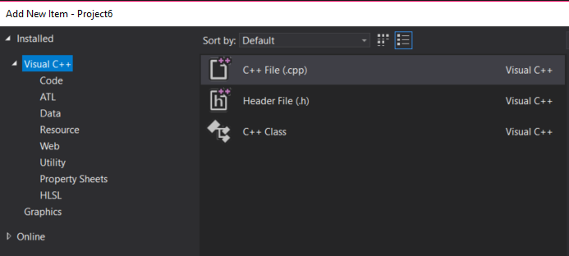
Separate source files

Slide 5
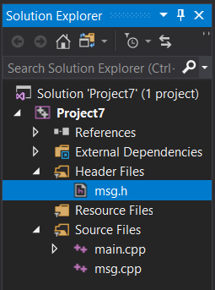
Separate source files

Slide 6
Objects & Classes

Slide 7
Four Principles of Object-Oriented Programming
Encapsulation
Inheritance
Polymorphism
Abstraction

Slide 8
Four Principles of Object-Oriented Programming
Encapsulation
binding together data and the functions that manipulate them
Inheritance
Polymorphism
Abstraction

Slide 9
Four Principles of Object-Oriented Programming
Encapsulation
binding together data and the functions that manipulate them
Inheritance
an entity can inherit attributes from another entity. It allows a programmer to create similar entities without needing to redefine similar attributes over and over
Polymorphism
Abstraction

Slide 10
Four Principles of Object-Oriented Programming
Encapsulation
binding together data and the functions that manipulate them
Inheritance
an entity can inherit attributes from another entity. It allows a programmer to create similar entities without needing to redefine similar attributes over and over
Polymorphism
Polymorphism means “having many forms”. We’ve already seen this in overloaded functions
Abstraction

Slide 11
Four Principles of Object-Oriented Programming
Encapsulation
binding together data and the functions that manipulate them
Inheritance
an entity can inherit attributes from another entity. It allows a programmer to create similar entities without needing to redefine similar attributes over and over
Polymorphism
Polymorphism means “having many forms”. We’ve seen this already in overloaded functions
Abstraction
the process of hiding all but the relevant information about a thing to make things less complex and more efficient for the user. For example, we don’t need to know how a clock works in order to use it to tell time. Abstraction lets you focus on what the thing does instead of how it does it.

Slide 12
Objects
Represent nouns: person, place, or thing
Groups data (variables, called attributes) and operations to be performed on that data (functions or procedures, called methods)

Slide 13
Classes – used to implement objects in C++
Terminology:
Class
Object
Instance

Slide 14
Classes – used to implement objects in C++
Class: like a blueprint for a house design, it represents the concept
Object: Any house built from that blueprint.
Instance: A specific house
Reality: object and instance are used interchangeably

Slide 15
Objects
int, float, string, etc. are finite data types
enum, struct, class, etc. are abstract data types (ADT)
studied in-depth in future courses
ADT is a means of working with high-level items while hiding low-level details from the user (programmer)

Slide 16
class <name> {
private:
public:
};

Slide 17
class student {
//private:
string name;
float GPA;
public:
void setName( const string );
void setGPA( const float );
string getName( ) const;
float getGPA() const;
};

Slide 18
class student {
public: void setGPA( const float );
private: float GPA;
public: void setName( const string );
public: string getName( ) const;
public: float getGPA() const;
private: string name;
};

Slide 19
student.cpp
#include “student.h”
float student::getGPA() const { return GPA;}
void student::setGPA( float gpa ){ GPA = gpa; }
student.h
#pragma once
#include <string>
class student {
//private:
string name;
float GPA;
public:
void setName( const string nm){ name = nm; } //inline def.
void setGPA( const float ); //prototype
string getName( ) const { return name; } //inline def.
float getGPA() const;
};
source.cpp
#include “student.h”
int main() {
inline int x;
student myStudent;
myStudent.setName( “Abe” );
myStudent.setGPA( 4.15 );
string nm = myStudent.getName();
cout << nm << myStudent.getName(); //both print “Abe”
return 0;
}

Slide 20
class student {
//private:
string name;
float GPA[10];
public:
void setName( const string nm){ name = nm; }
void setGPA( float [], int ); //prototype only
void setGPA( float, int );
string getName( ) const { return name; } //prototype & definition, inline definition
float getGPA() const;
};
float student::getGPA() const { return GPA[0];} //definition
void student::setGPA( float g[], int cnt ) {
int i;
for( i=0; i<cnt; i++ ){
GPA[i] = g[i];}
}
void student::setGPA( float g, int pos ) {
GPA[pos] = g;
}
main(){
float grades[10], grade;
student myStudent;
myStudent.setGPA( grades, 10 );
myStudent.setGPA( 3.15, 4 );

Slide 21
student myStudents[50];
myStudents[ x ].setName( “Abe” );
for (int i=0; i <10;i++)
myStudents[ i ].setGPA( 3.15, 1 );

Slide 22
header file guards (or wrapper)
#ifndef MYFILE_H
#define MYFILE_H
#endif
can be replaced by
#pragma once

Slide 23
header file guards
#pragma once //non-standard but supported by many compilers
//works great for smaller programs but has potential issues with very large ones
//my advice: continue to use standard file guard

Slide 24
Namespaces
Primarily used when programming in groups. It adds another, higher level of separation.
Example:
Programmer A creates class box
Programmer B creates class box
programmer C needs to use both classes
box myBox; //which programmers class does it refer to, A or B?

Slide 25
Namespaces
Solution is to create namespaces so proper identification can be made
namespace ProgA {
class box { }
}
namespace ProgB {
class box { } }
using namespace ProgA;
using namespace ProgB;
ProgA::box myBox;
ProgB::box BBox;

Slide 26
Namespaces
Other than std you are unlikely to see namespaces unless working on large projects, with many programmers.
online you’ll quite often see
std::cout << "Hello";

Slide 27
static data members – similar to global variables
class student {
private: string name;
float GPA;
int stuNum;
public:
static int stuCnt; //static variable – member of class, not instance
int setCnt() { stuNum = ++stuCnt; }
};
int main() {
student myStudents[5];
int student::stuCnt = 0; //initialize static variable
myStudents[0].setCnt(); //set to 1
myStudents[1].setCnt(); //set to 2

Slide 28
static methods – can only access static variables
class student {
private: string name;
float GPA;
int stuNum;
static int stuCnt; //static variable
public:
static int getCnt() {return stuCnt; } //static method for class (all instances)
};
int main() {
student myStudents[5];
cout << student::getCnt() << endl; //calls class method, not instance method
}

Slide 29
Class Initialization
class student {
private: string name = “Adam”; //initial value
float GPA = 0.00;
public:
void setName( string nm ){ name = nm; } //inline function definition
};

Slide 30
Class Initialization via constructor method
class student { //normally student.h
private: string name;
float GPA;
public:
void setName( string nm ){ name = nm; }
student(); //constructor prototype, called default constructor
};
student::student() { //normally student.cpp
name = “Bob”;
GPA = 0.00;
}
int main() { //normally source.cpp
student myStudent; //constructor called automatically

